Slide 1
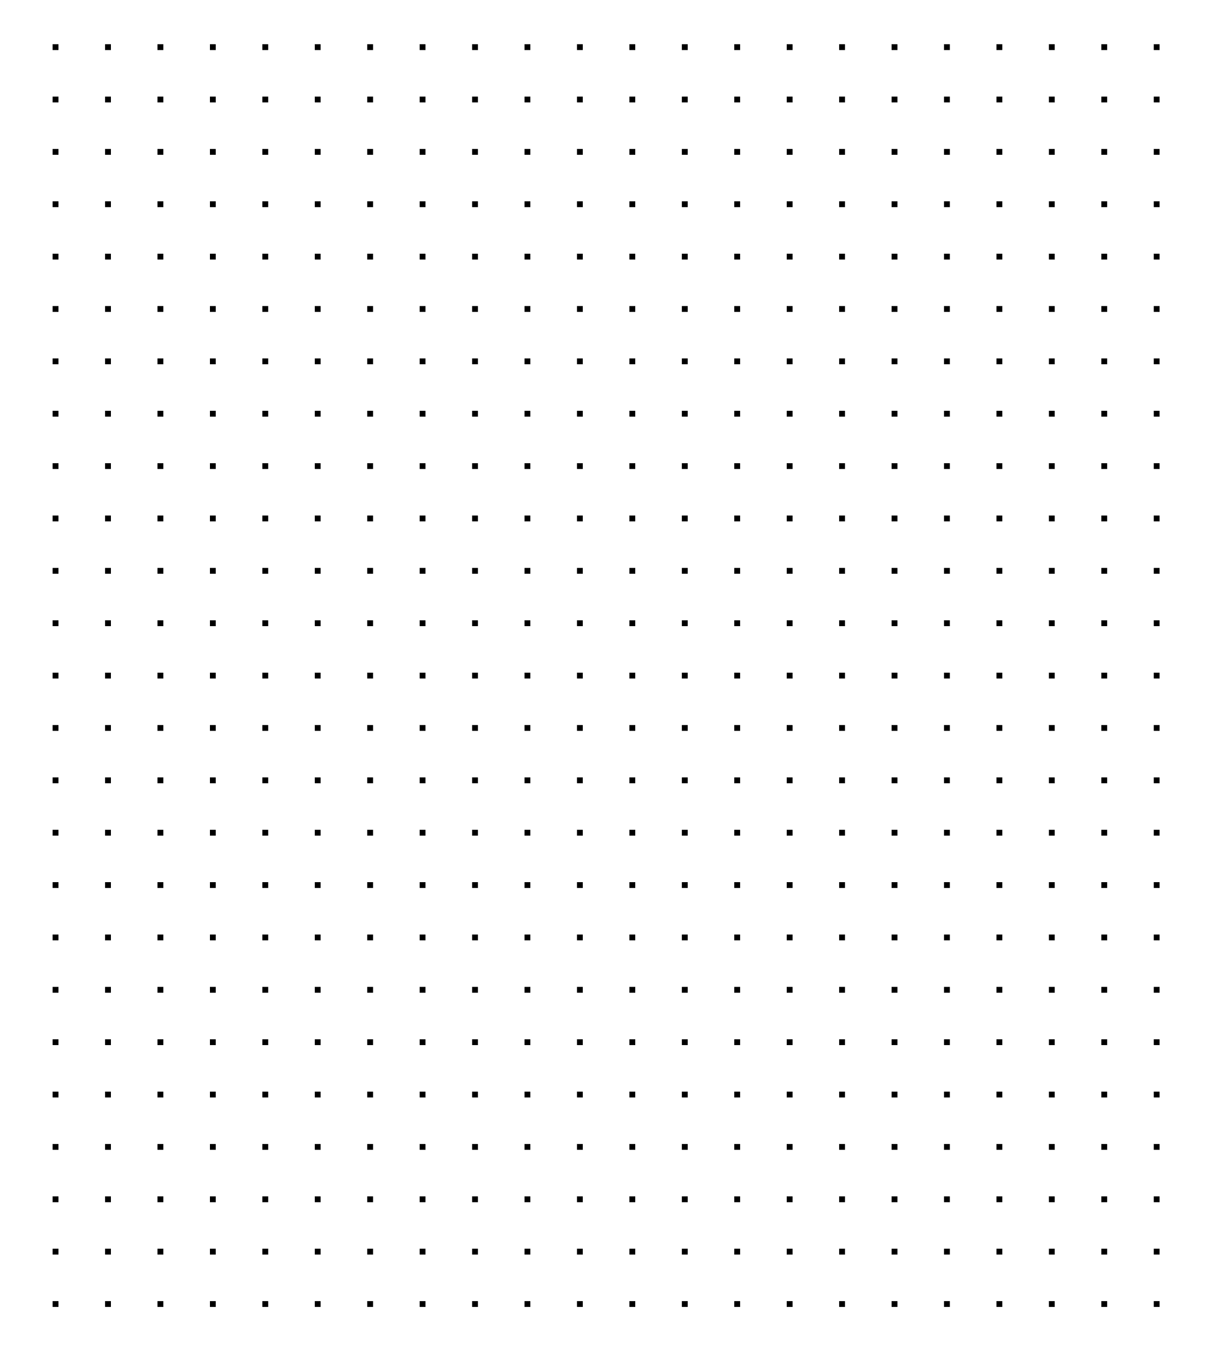
RPA Design & Development
Control Flow

Slide 2
Control Flow
The order in which individual statements, instructions or function calls are executed or evaluated in a software project. Control flow statements can be categorized by their effect:
Continuing at a different statement
Executing and returning
Preventing any further execution
Executing only if some condition is met
Executing until some condition is met

Slide 3
Basic Control Statements
If
One condition, two outcomes.
Switch
When a single condition generates more than two options, Switch is the most efficient statement
Loop
The repetition of set of instructions based on the condition
Break
Breaks are paired with Loop statements in order to interrupt them; otherwise Loops would continue indefinitely

Slide 4

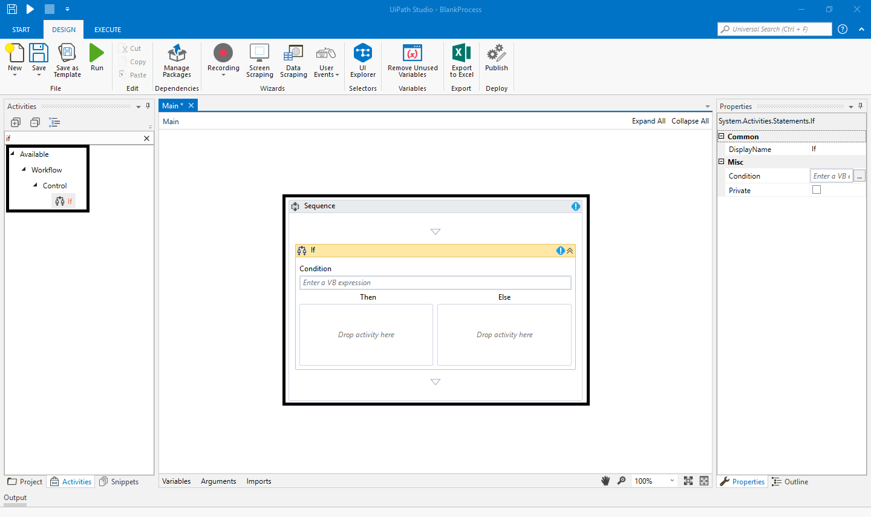
If
The If Statement
The basic concept of If statement is a method of two activity (Then and Else) which contain two condition and one statement.
Switch
Loop
Break

Slide 5
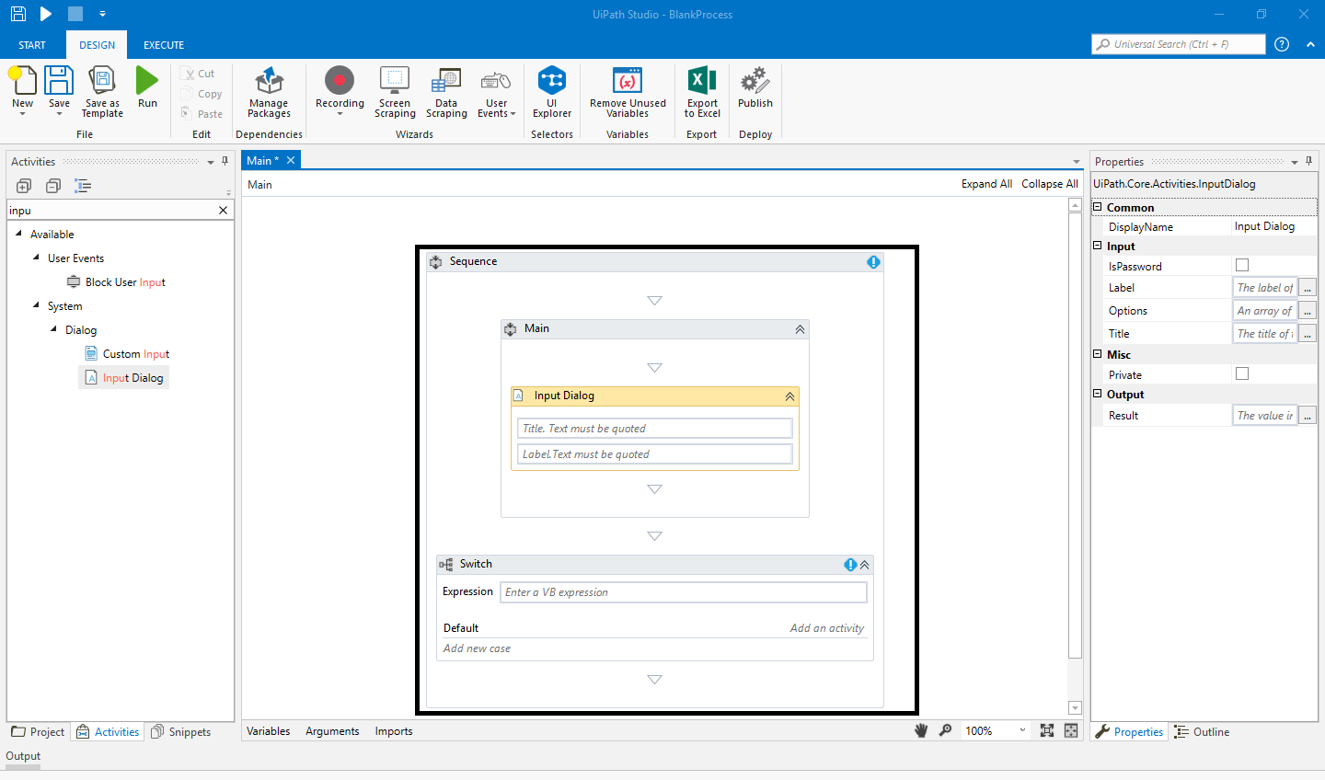
If
The Switch Statement
The Switch statement allows one value out of multiple values by specified expression.
Switch
Condition: It processes only integer argument values.
Use: It is useful in the number of processes.
Loop
Break

Slide 6
Practice makes Perfect…
An old Mesopotamian saying goes like this…
“Blue eyes are a sign of Bravery, Green eyes are a sign of Generosity, Gray eyes are a sign of Wisdom”
Having a simple user input field (‘What is the color of your eyes?’), how would you use the Switch statement to give the user a unique input?
How would it look like using only If statements?

Slide 7
Comparison of If and Switch
If
Switch
IF V = ‘Blue’ THEN print ‘You must be very brave’
ELSE (IF V = ‘Green’ THEN print ‘You must be very generous’
ELSE (IF V= ‘Gray’ THEN print ‘You must be very wise’
ELSE print ‘You must be a god, because you don’t have human eyes’))
SWITCH
Case V = ‘Blue’ print ‘You must be very brave’
Case V = ‘Green’ print ‘You must be very generous’
Case V = ‘Gray’ print ‘You must be very wise’
Default Case print ‘You must be a god, because you don’t have human eyes’

Slide 8
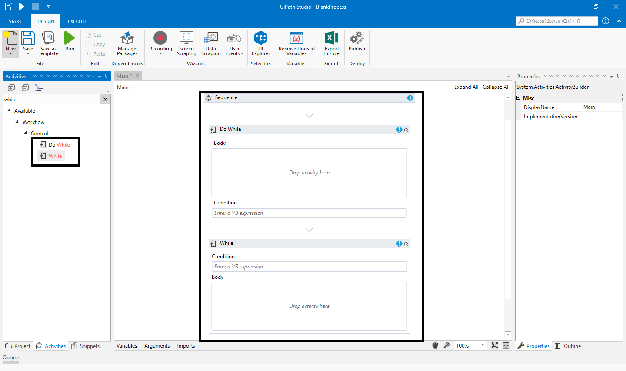
If
The Loop Statement
Loop is the structure that executes a repetitive set of operations with these low error activities.
Switch
Loop
Break

Slide 9
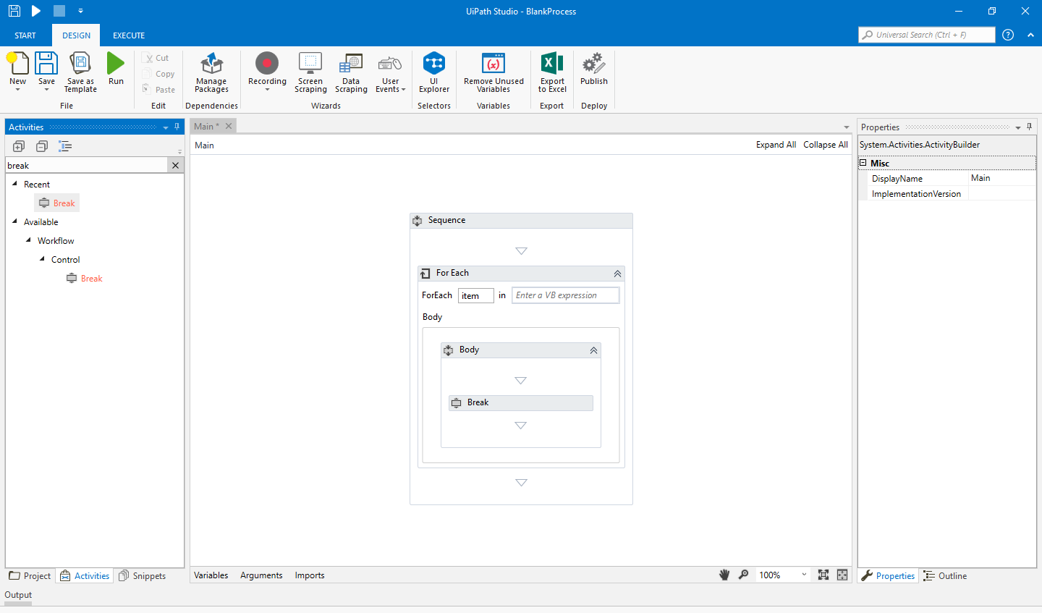
If
The Break Statement
It is the process in the UiPath Studio which allows to break an activity on the chosen or starting point.
Switch
Loop
Break

Slide 10
Practice makes Perfect…
Consider an online game of ‘Guess the price’:
A product is being advertised using a video;
Once the video ends, the bidding starts: each connected user has 60 seconds to introduce the price he thinks the product is worth it (only one amount);
The winner is the first user that guessed the price.
How would you solve this using a loop?

Slide 11






Control Flow Statements in UiPath
Assign
While
Delay
Switch
Do While
?
If
For Each
Break

Slide 12
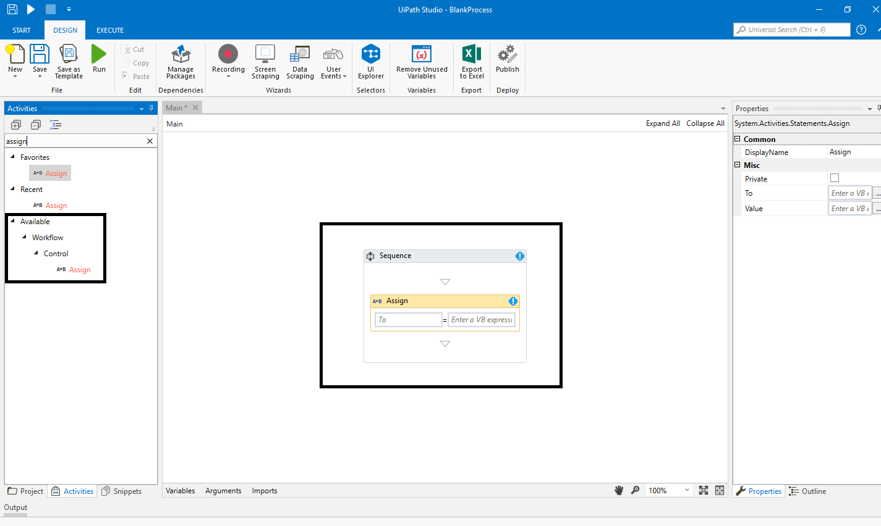
Assign
The Assign statement allocates a value to a variable or argument.
What it can be used for?
Increment the value of a variable in a loop
Sum up two or more variables and assign the result to a different variable
Assign values to an array

Slide 13
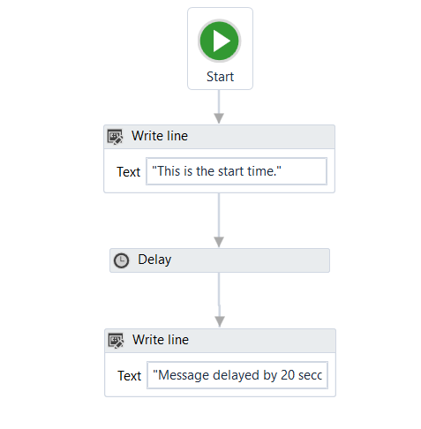
Delay
The Delay statement pauses an automation for a period of time.
What it can be used for?
Machine Latency: Delay is used to solve this issue which lead to error.

Slide 14
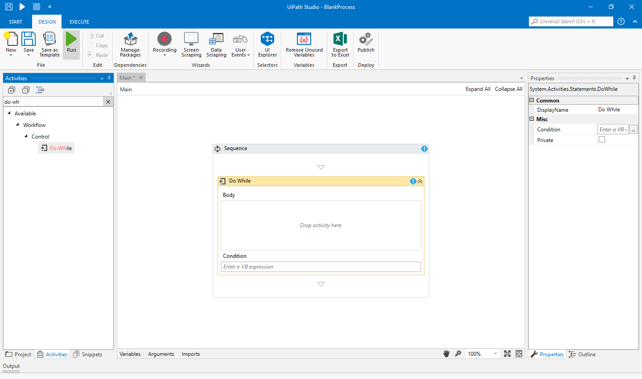
Do While
The Do While statement creates a loop that executes a specific sequence while a condition is met. The condition is evaluated after each execution of the statement

Slide 15
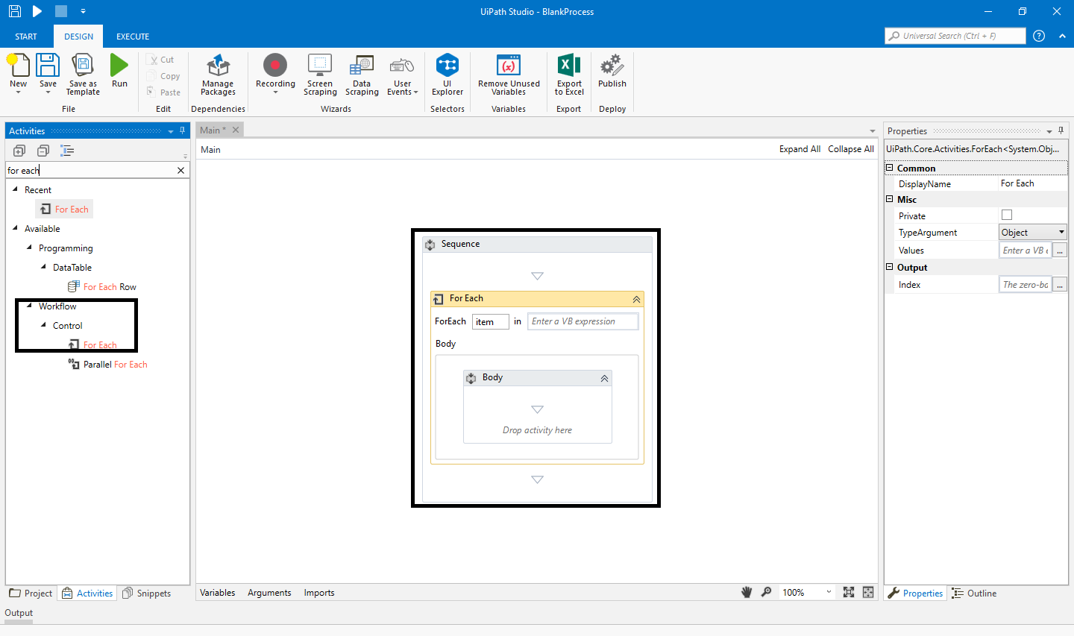
For Each
The For Each statement performs an activity or a series of activities on each element of a collection.

Slide 16
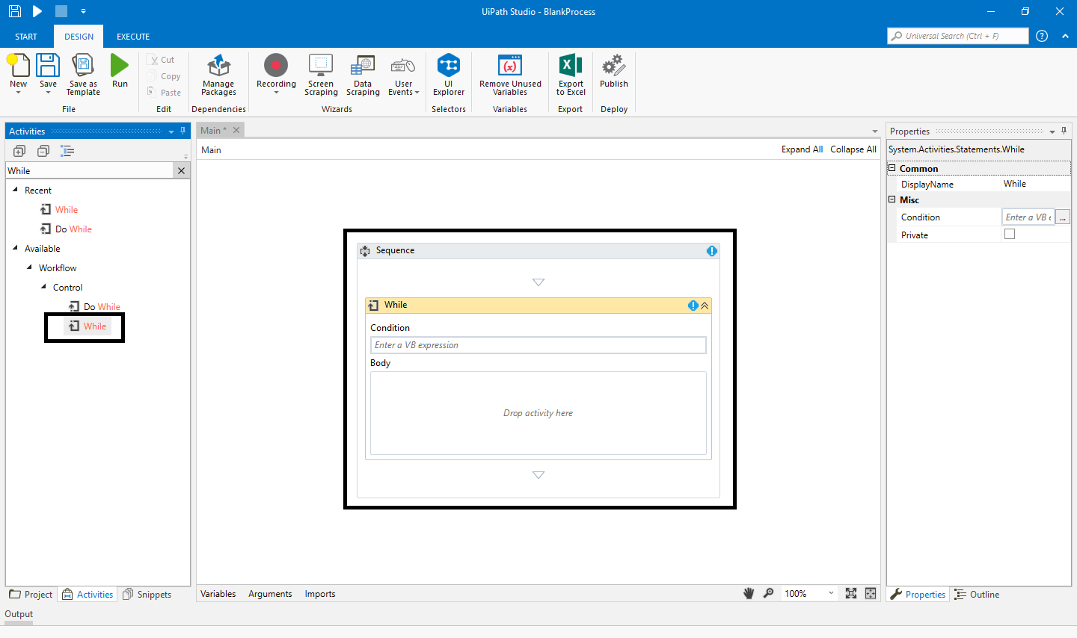
While
The While statement creates a loop that executes a specific sequence and the condition is evaluated before the execution of each statement.

Slide 17
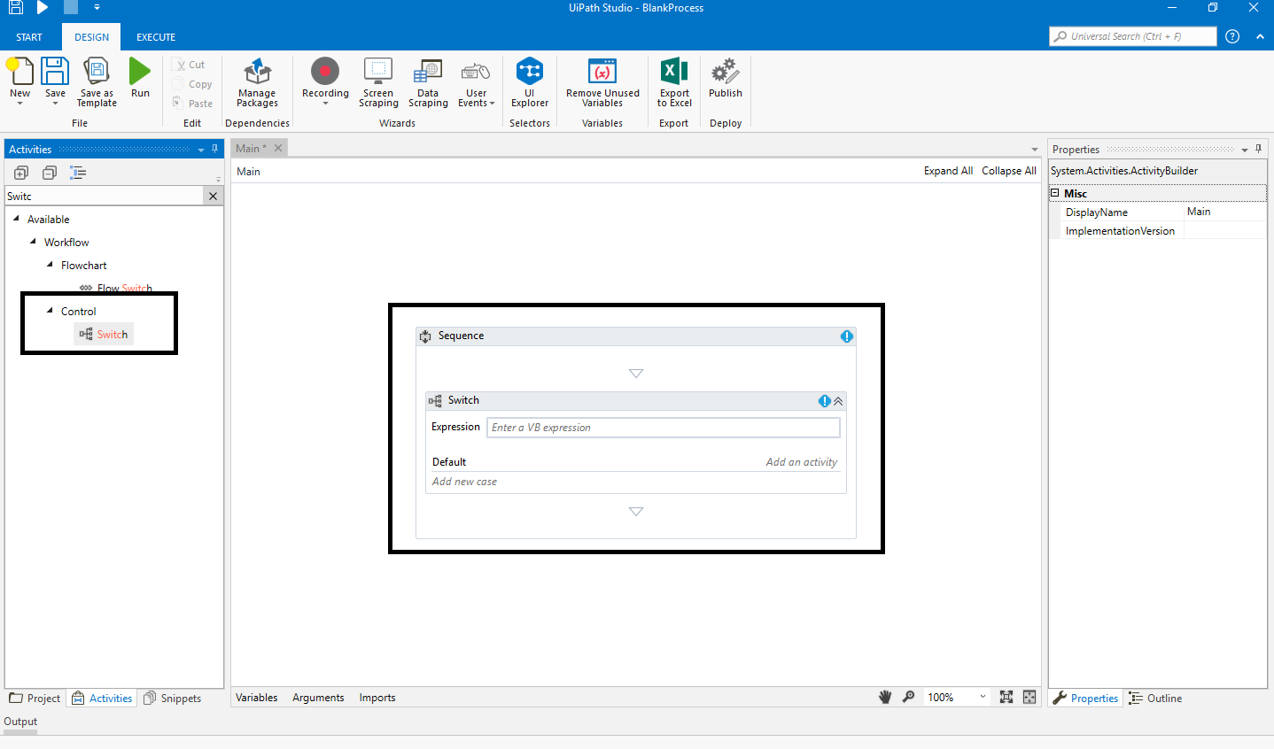
Switch
The Switch statement executes a set of statements out of multiple statements, based on the value of a specific expression.

Slide 18
If
The If statement enables a project to take one of two different courses of action, depending on whether a specified condition is met.

Slide 19
Break
The Break statement stops the loop at a chosen point and continues with the next activity.

Slide 20
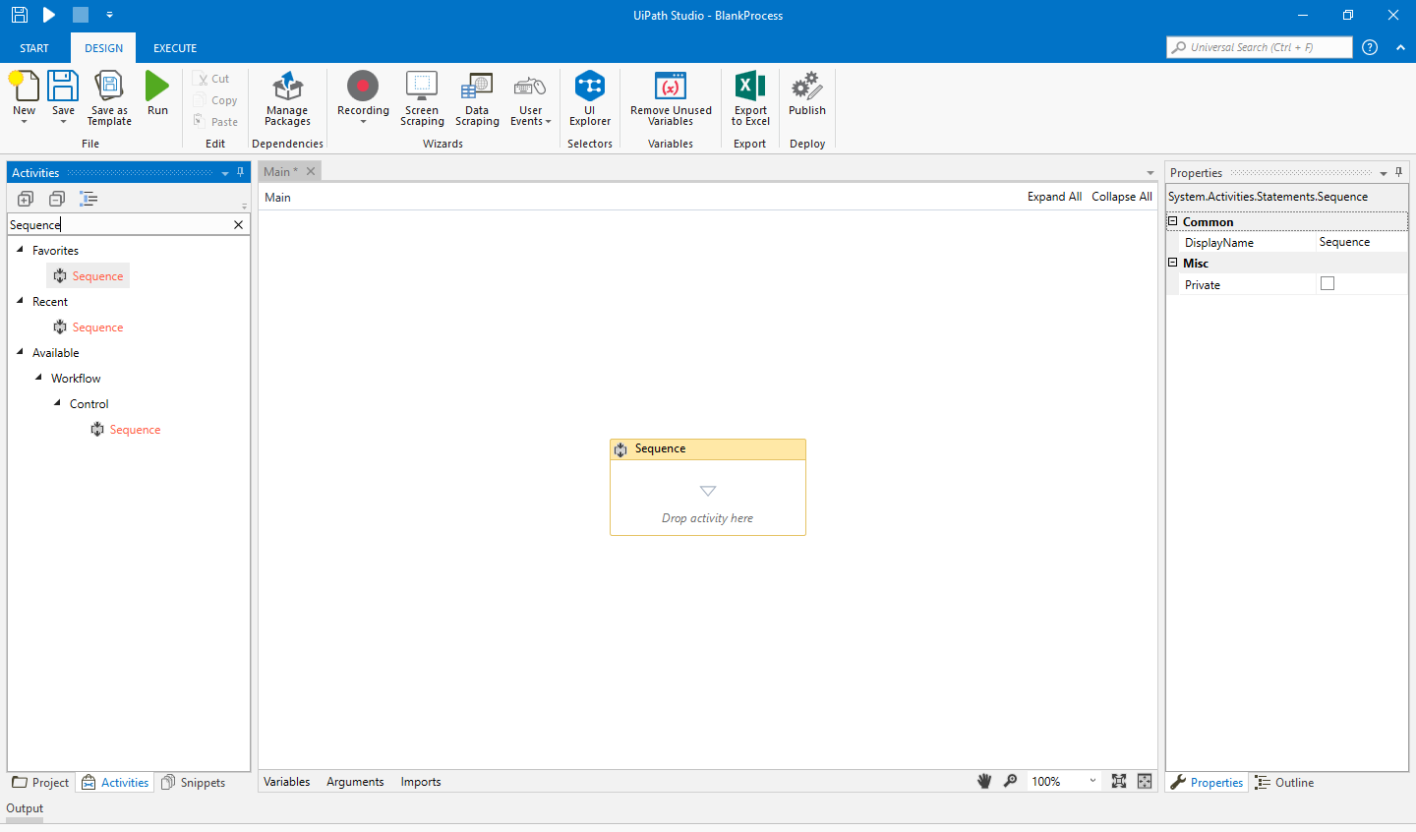
Sequence
Sequence is the smallest project to create a process in UiPath that enables to create a linear process in various activities and execute the sequential order.

Slide 21
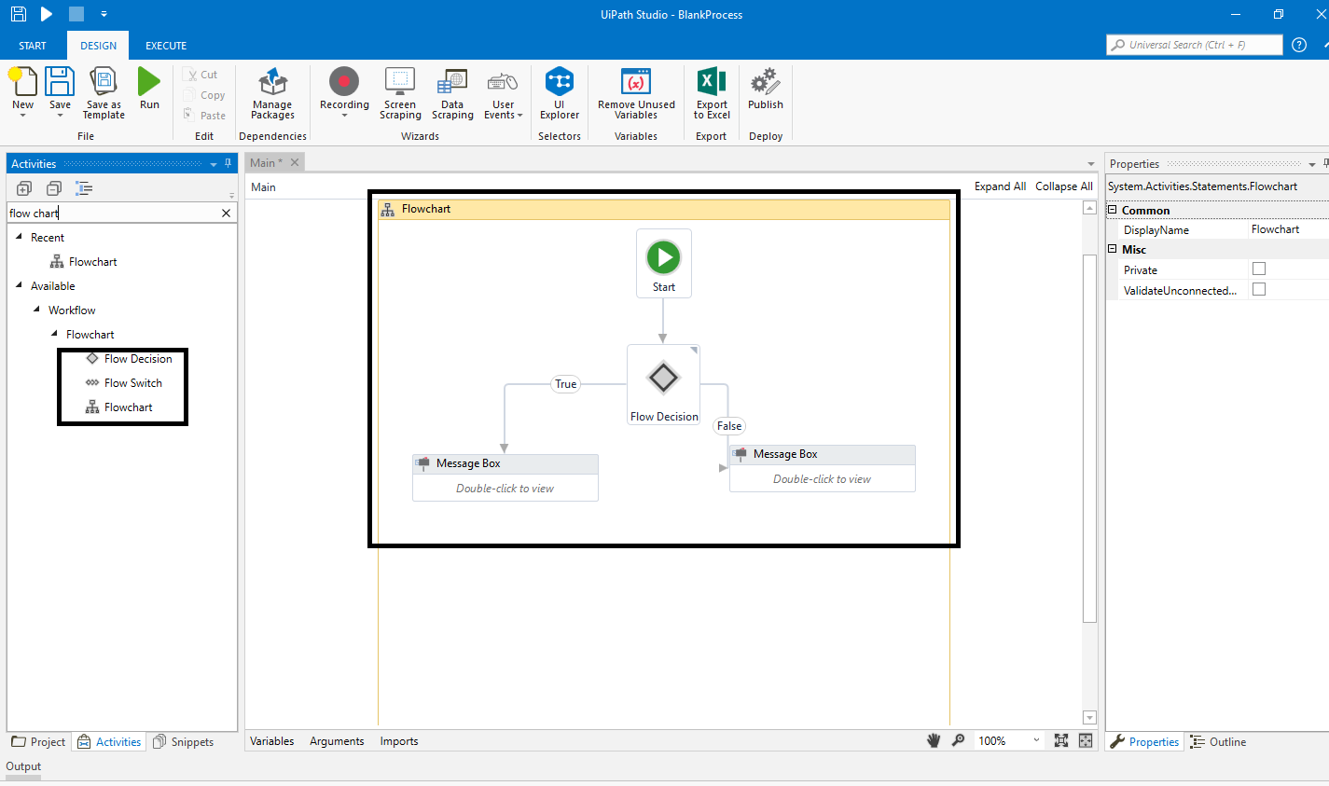
Flowchart
The Flowchart represents various steps involved in completing activities, task, and process.

Slide 22
Exercise…
Create a list of songs of an artist from YouTube
Now that you are familiar with the control flow statements in UiPath, can you translate the solution to our task into UiPath Studio?

Slide 23

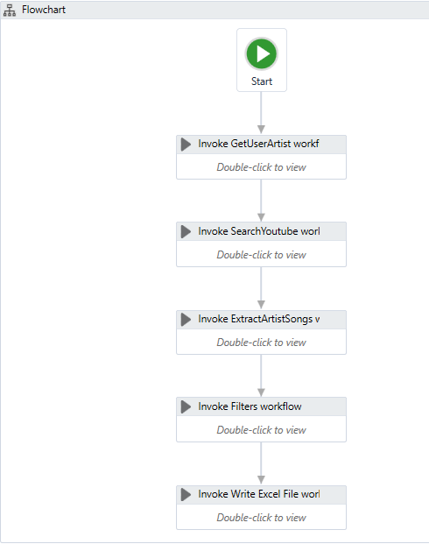
Create a list of songs of an artist from YouTube
Main steps of the solution:
Get the artist name and store it as an argument (GetUserArtist workflow)
Open YouTube with Chrome browser, search for the artist, sort the results by view count (SearchYouTube workflow)
Scrape the relevant data from the search results and store them inside a DataTable argument (ExtractArtistSongs workflow)
Filter the results in the DataTable (Filters workflow)
Write the filtered results in the Excel file (WriteExcelFile workflow)

Slide 24
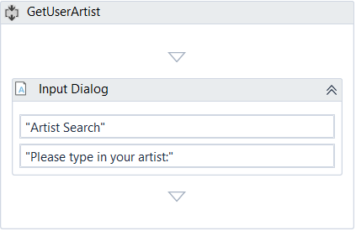
Step 1: GetUserArtist Workflow
Purpose: Get the artist name and store it as an argument
Activities:
Input Dialog to ask the user for the artist name
Variables/Arguments:
Argument: ArtistName (type: string, direction out)

Slide 25
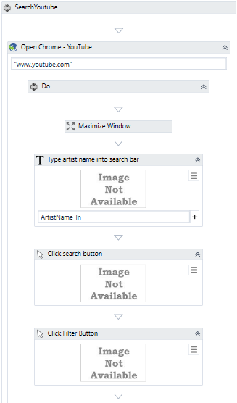
Step 2: SearchYouTube Workflow (part 1)
Purpose: Open YouTube with Chrome browser, search for the artist, sort the results by view count
Activities:
OpenBrowser Chrome – www.youtube.com
Do
Maximize the window
TypeInto for searching the artist name
Click search button
Click fiter
Variables/Arguments:
Argument: ArtistName (type: string, direction in)

Slide 26
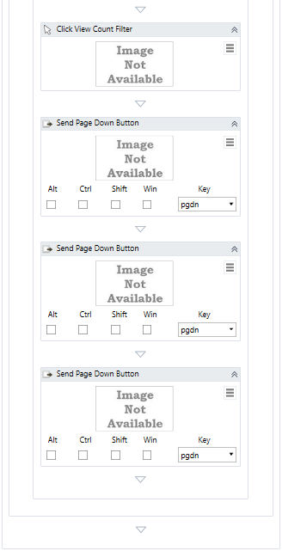
Step 2: SearchYouTube Workflow (part 2)
Purpose: Open YouTube with Chrome browser, search for the artist, sort the results by view count
Activities:
Click View Count
Variables/Arguments: -
No variables and arguments are needed.

Slide 27
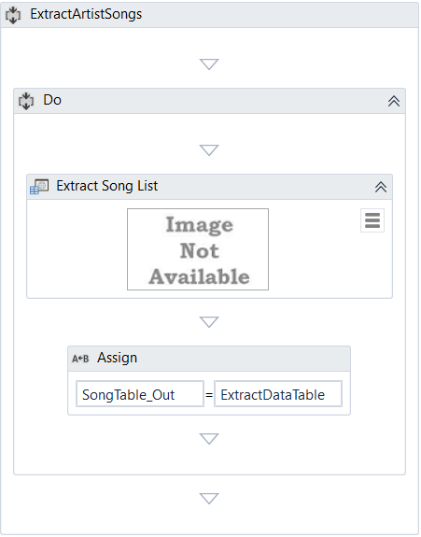
Step 3: ExtractArtistSongs Workflow
Purpose: Scrape the relevant data from the search results and store them inside a DataTable argument
Activities:
Do
ExtractData for extracting the information for each song on the page and store it in a variable
Assign the info extracted to an argument
Variables/Arguments:
Variable: Song table (type: DataTable)
Argument: Song table (type: DataTable, direction: out)

Slide 28
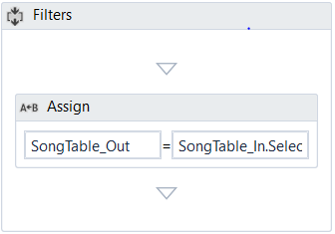
Step 4: Filters Workflow
Purpose: Filter the results in the DataTable Activities:
Assign to filter out the unwanted results in the DataTable (live songs & songs from other artists)
Variables/Arguments:
Argument: SongTable_In (DataTable, direction: in) – extracted data
Argument: Song table (DataTable, direction: out) – filtered data
Argument: ArtistName_IN (String, direction: in) – filter out results

Slide 29
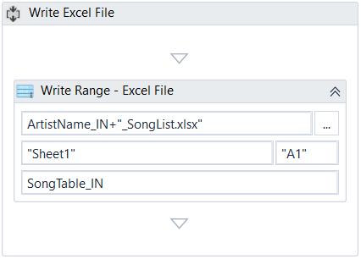
Step 5: WriteExcelFile Workflow
Purpose: Write the filtered results in the Excel file Activities:
WriteRange for writing the filtered data in a new Excel file
Variables/Arguments:
Argument: SongTable_In (DataTable, direction: in) – filtered data
Argument: ArtistName_IN (String, direction: in) – filter out results

Slide 30
Takeaways
Control Flow & Universal Statements
Control Flow is the order in which individual statements, instructions or function calls are executed or evaluated in a software project.
There are four basic control statements:
If
Switch
Loop
Break

Slide 31
Takeaways
Control Flow Statements in UiPath
There are eight different types of control flow statement that are used in UiPath.
UiPath Control Flow Statements:
Assign
Break
Delay
Do While
For Each
If
Switch
While

Slide 32
Questions & Answers

Slide 33
Let’s take a variable (V) initially assigned with a value of 10 and decreasing by 1 every time a sequence is executed in a Do While Statement. How many times will the sequence be executed if the expression is V > 0?
a) 11
b) 10
c) 9

Slide 34
Which activity can be used to process every item in a collection individually?
a) Do while
b) If
c) For each

Slide 35
Next Steps
Data Manipulation

